Slide 1

Hyperparameter Tuning Using Hyperopt
Abhishek Periwal
Notes:
abc

Slide 2
Agenda
Hyperparameter Tuning
Objective Function
Traditional Methods
Sequential Model Based Optimisation
Bayesian Optimisation
Surrogate Function
Acquisition Function
Tree Parzen Estimator
Hyperopt
Workflow
Hack Session
Drawbacks

Slide 3
About Me
IIT Kanpur 2013 Graduate
Currently working with Flipkart
Worked with Paytm, Lendingkart, Mu-Sigma
Work
Domain - Credit Risk Models, Product Adoption
Tech Stack - Python, Spark, R
Last Dataset Used
~10M observations, 2000+ variables, lightgbm algorithm
Grid Search | Random Search | Hyperopt
~6000 iterations, ~144 hrs | ~2500 iterations, ~60 hrs | ~1000 iterations, ~26 hrs

Slide 4
Modelling Workflow
Feature Engineering
Feature Selection
Model Building
Decide Algorithm
Choose Training Strategy
Tune Hyperparameters

Slide 5
Objective Function
Objective function is function of Data and Hyperparameter (we are maximising/minimizing a metric)
Objective Function = 𝒇(hyperparameter, data)
Since data is constant here (post deciding features and training strategy)
Objective Function = 𝒇(hyperparameter) given data
So Problem we are addressing is - Find optimum hyperparameter from the model
Objective Function
Data
Hyperparameter

Slide 6
Objective Function
Objective Function is function of hyperparameter
Goal - Optimize hyperparameter to search maxima / minima of objective function with less number of iterations to tune hyperparameter
Since we don’t know how function looks like (black box function), we approximate function by surrogate function
f̂ ≈ f
And we choose Surrogate function which is cheap to evaluate

Slide 7
Hyperparameter Tuning
find hyperparameter to get max/min of objective function 𝒇(hyperparameter)
Goal - Optimize hyperparameter to search maxima/minima of objective function
Since we don’t know how function looks like we will call it black box function
How we can find hyperparameter to maximise objective function?
Known Gradient
Gradient Descent Method
Unknown Gradient
Numerically Estimate
Grid Search or Random Search

Slide 8
Traditional Methods
Grid Search
Key idea is to define a set of parameter values and train the model for all possible combinations and then select the best one. This method is pretty good if you have a simple model, but if your model takes some time to train or if your hyperparameter space is too big, this approach could not be the best one, because of the time required to do it.
Random Search
Algorithm is pretty similar, but instead of using all possible combinations, it randomly assigns a value (within a defined range) for each hyperparameter, so the required time could decrease significantly. However, it might not find the optimal set.
“These algorithms don’t learn from past to optimise future”

Slide 9
SMBO (Sequential Model Based Optimisation)
Define Hyperparameter Domain
Define
Objective Function
Assume Surrogate Function
Define
Acquisition Function
Update Surrogate Function
Like max_depth, learning_rate in xgboost etc.
Evaluation metric to optimise
AUC, log-loss, RMSE etc.
Dummy function of objective function
f̂ ≈ f
To evaluate which hyperparameters to choose next
According to history of Score and Hyperparameter Set
Domain of Hyperparameter from which we have to choose optimal one like in xgboost
max_depth (2, 3, 4, 5, …..)
learning_rate (0.01, 0.015, 0.02, 0.025, …..)
feature_fraction (0.1, 0.2, 0.3, .....)
etc.

Slide 10
SMBO (Sequential Model Based Optimisation)
Define Hyperparameter Domain
Define
Objective Function
Assume Surrogate Function
Define
Acquisition Function
Update Surrogate Function
Like max_depth in xgboost, learning_rate etc.
Like AUC, log-loss, RMSE etc. for train, hold out or test set
Dummy function of objective function
f̂ ≈ f
To evaluate which hyperparameters to choose next
According to history of Score and Hyperparameter Set
Define which metric to optimise
For classification - auc, log-loss, precision score etc.
For regression - rmse, mean absolute error, adjusted R square etc.
Define for which dataset we have to optimise
k-fold cross-validation on train
test / val
hold out set

Slide 11
SMBO (Sequential Model Based Optimisation)
Define Hyperparameter Domain
Define
Objective Function
Assume Surrogate Function
Define
Acquisition Function
Update Surrogate Function
Like max_depth in xgboost, learning_rate etc.
Like AUC, log-loss, RMSE etc. for train, hold out or test set
Dummy model of objective function
f̂ ≈ f
To evaluate which hyperparameters to choose next
According to history of Score and Hyperparameter Set
Dummy function of model function
f̂ ≈ f
The probability representation of the objective function built using previous evaluations

Slide 12
SMBO (Sequential Model Based Optimisation)
Define Hyperparameter Domain
Define
Objective Function
Assume Surrogate Function
Define
Acquisition Function
Update Surrogate Function
Like max_depth in xgboost, learning_rate etc.
Like AUC, log-loss, RMSE etc. for train, hold out or test set
Dummy function of objective function
f̂ ≈ f
To evaluate which hyperparameters to choose next
According to history of Score and Hyperparameter Set
The acquisition function is the criteria by which the next set of hyperparameters are chosen from the surrogate function

Slide 13
SMBO (Sequential Model Based Optimisation)
Define Hyperparameter Domain
Define
Objective Function
Assume Surrogate Function
Define
Acquisition Function
Update Surrogate Function
Like max_depth in xgboost, learning_rate etc.
Like AUC, log-loss, RMSE etc. for train, hold out or test set
Dummy function of objective function
f̂ ≈ f
To evaluate which hyperparameters to choose next
According to history of Score and Hyperparameter Set
According to history of Score and Hyperparameter Set including evaluation of latest point acquired by Acquisition Function
There are various variants of SMBO methods, which majorly differ in
Surrogate Function
Acquisition Function

Slide 14
Bayesian Optimization
Bayesian Optimisation builds a probability model of the objective function and uses it to select optimum set of hyperparameter to evaluate true objective function.
Choose Hyperparameter that maximises some utility over current belief
Evaluate Objective Function for set of hyperparameter
Bayesian Optimisation
Update current belief of distribution of objective function

Slide 15
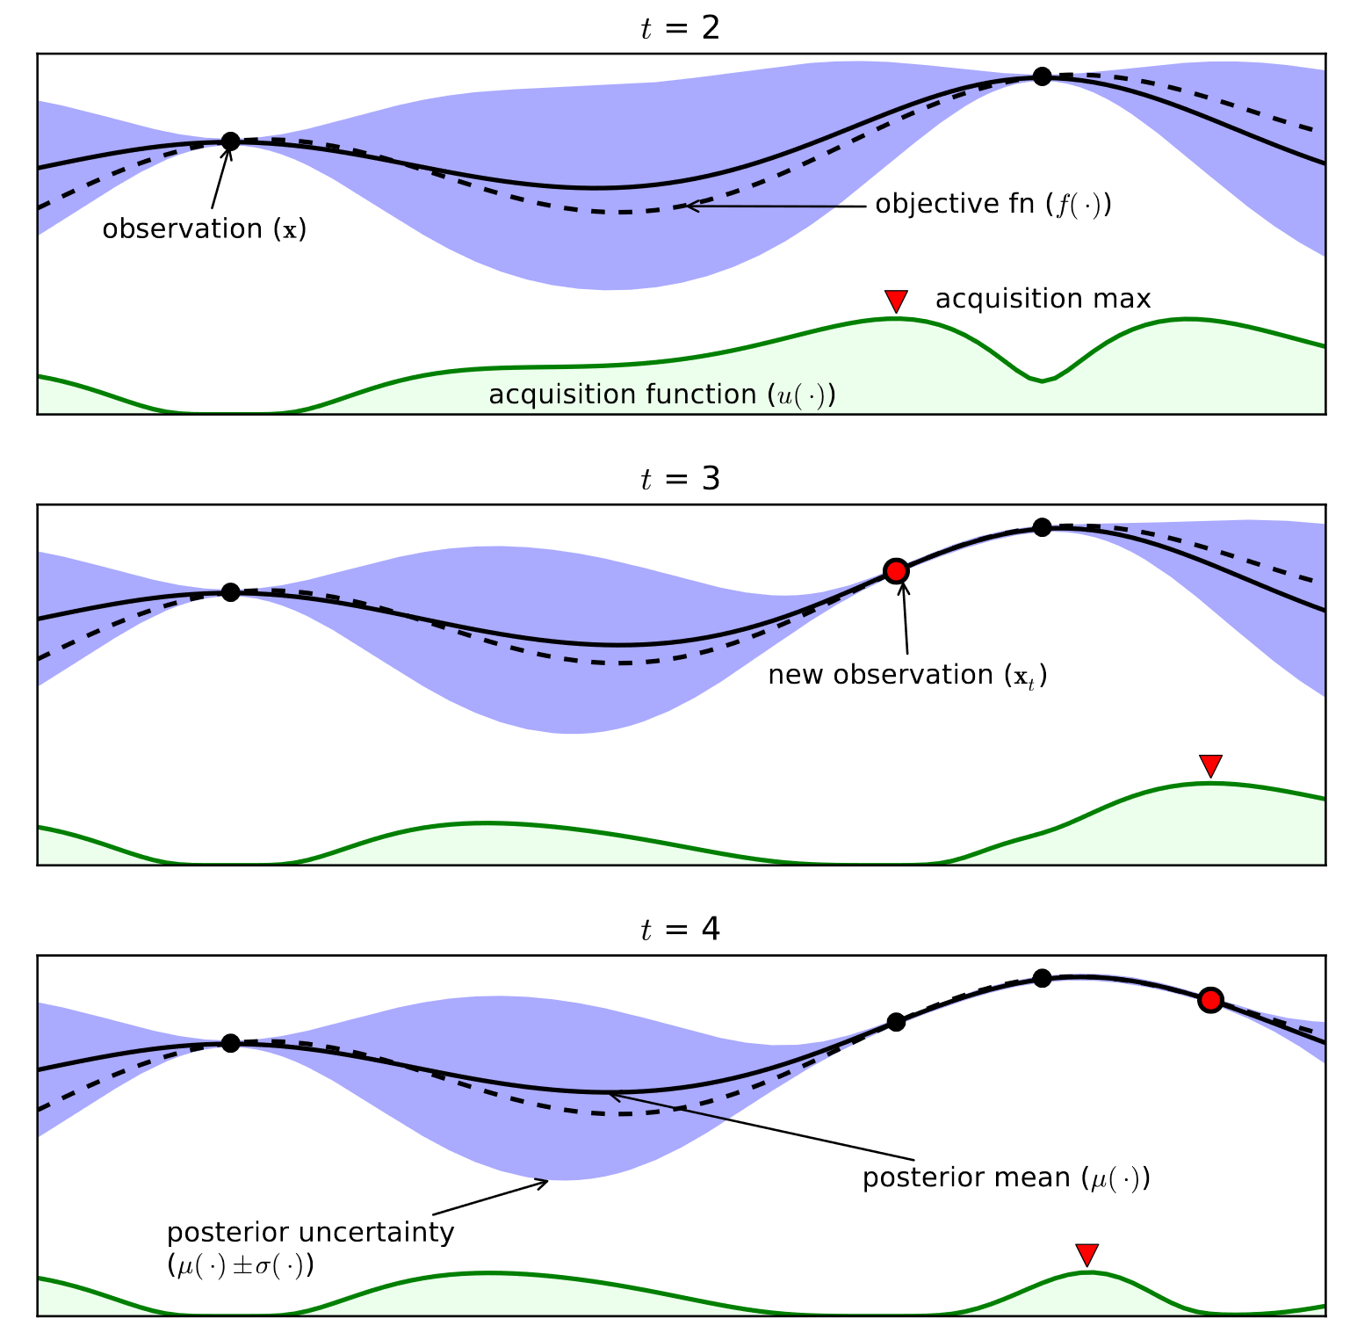
Bayesian Optimization

Slide 16
Bayesian Optimization

Slide 17
Bayesian Optimization

Slide 18
Bayesian Optimization

Slide 19
Bayesian Optimization

Slide 20
Surrogate Function
Surrogate Function
(Response Surface)
Probability representation of the objective function built using previous evaluations
Should be arbitrary complex function
high-dimensional mapping of hyperparameters to the probability of a score
Profitable to Estimate uncertainty
Few Examples
Gaussian Processes
Random Forest regression
Tree-structured Parzen Estimator

Slide 21
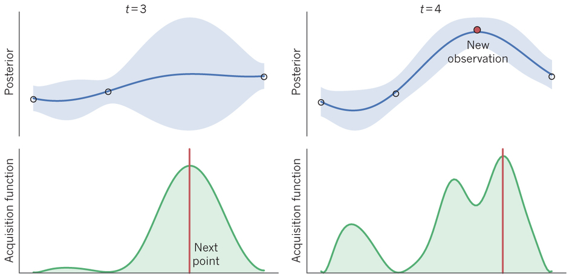
Acquisition Function
The Acquisition function is the criteria by which the next set of hyperparameters are chosen from the surrogate function.
Following are few examples
Maximum probability of improvement
Upper confidence bound
Expected Improvement
The most common choice of criteria is Expected Improvement
(Expected value of gain we get after sampling at that point)

Slide 22
Tree Parzen Estimator -TPE
models p(hyperparameter | loss) and p(loss)
Start sampling the response surface by randomly
num_leaves | rmse
3 | 57.9
4 | 54.5
6 | 54.9
9 | 56.1
11 | 56.2
22 | 55.1
23 | 54.5
28 | 55.4
35 | 55
37 | 56.7
38 | 55.7
43 | 54
43 | 57.2
49 | 55.2

Slide 23
Tree Parzen Estimator -TPE
num_leaves | rmse
43 | 54
4 | 54.5
23 | 54.5
6 | 54.9
35 | 55
models p(hyperparameter | loss) and p(loss)
Start sampling the response surface by randomly
Split the observations in two groups: the Good one (e.g. the upper quartile) and the Rest
num_leaves | rmse
3 | 57.9
4 | 54.5
6 | 54.9
9 | 56.1
11 | 56.2
22 | 55.1
23 | 54.5
28 | 55.4
35 | 55
37 | 56.7
38 | 55.7
43 | 54
43 | 57.2
49 | 55.2
Good Group
num_leaves | rmse
22 | 55.1
49 | 55.2
28 | 55.4
38 | 55.7
9 | 56.1
11 | 56.2
37 | 56.7
43 | 57.2
3 | 57.9
Rest Group

Slide 24
Tree Parzen Estimator -TPE
num_leaves | rmse
43 | 54
4 | 54.5
23 | 54.5
6 | 54.9
35 | 55
models p(hyperparameter | loss) and p(loss)
Start sampling the response surface by randomly
Split the observations in two groups: the Good one (e.g. the upper quartile) and the Rest
Define y* as splitting value
here, y* = 55.1
num_leaves | rmse
3 | 57.9
4 | 54.5
6 | 54.9
9 | 56.1
11 | 56.2
22 | 55.1
23 | 54.5
28 | 55.4
35 | 55
37 | 56.7
38 | 55.7
43 | 54
43 | 57.2
49 | 55.2
Good Group
num_leaves | rmse
22 | 55.1
49 | 55.2
28 | 55.4
38 | 55.7
9 | 56.1
11 | 56.2
37 | 56.7
43 | 57.2
3 | 57.9
Rest Group

Slide 25
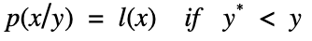
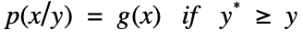
Tree Parzen Estimator -TPE
num_leaves | rmse
43 | 54
4 | 54.5
23 | 54.5
6 | 54.9
35 | 55
models p(hyperparameter | loss) and p(loss)
Start sampling the response surface by randomly
Split the observations in two groups: the Good one (e.g. the upper quartile) and the Rest
Define y* as splitting value
here, y* = 55.1
Model the likelihood probability for being in each of these groups
num_leaves | rmse
3 | 57.9
4 | 54.5
6 | 54.9
9 | 56.1
11 | 56.2
22 | 55.1
23 | 54.5
28 | 55.4
35 | 55
37 | 56.7
38 | 55.7
43 | 54
43 | 57.2
49 | 55.2
Good Group
ℓ(x)
num_leaves | rmse
22 | 55.1
49 | 55.2
28 | 55.4
38 | 55.7
9 | 56.1
11 | 56.2
37 | 56.7
43 | 57.2
3 | 57.9
𝑔(x)
Rest Group

Slide 26
Tree Parzen Estimator -TPE
num_leaves | rmse
43 | 54
4 | 54.5
23 | 54.5
6 | 54.9
35 | 55
models p(hyperparameter | loss) and p(loss)
Start sampling the response surface by randomly
Split the observations in two groups: the Good one (e.g. the upper quartile) and the Rest
Define y* as splitting value
here, y* = 55.1
Model the likelihood probability for being in each of these groups
Probabilities ℓ and 𝑔 are modeled using Parzen estimators and p(y) is modeled using the fact that p(y<y*) = 𝞬
num_leaves | rmse
3 | 57.9
4 | 54.5
6 | 54.9
9 | 56.1
11 | 56.2
22 | 55.1
23 | 54.5
28 | 55.4
35 | 55
37 | 56.7
38 | 55.7
43 | 54
43 | 57.2
49 | 55.2
Good Group
ℓ(x)
num_leaves | rmse
22 | 55.1
49 | 55.2
28 | 55.4
38 | 55.7
9 | 56.1
11 | 56.2
37 | 56.7
43 | 57.2
3 | 57.9
𝑔(x)
Rest Group

Slide 27
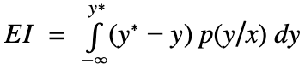
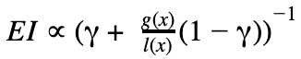
Tree Parzen Estimator -TPE
num_leaves | rmse
43 | 54
4 | 54.5
23 | 54.5
6 | 54.9
35 | 55
models p(hyperparameter | loss) and p(loss)
Start sampling the response surface by randomly
Split the observations in two groups: the Good one (e.g. the upper quartile) and the Rest
Define y* as splitting value
here, y* = 55.1
Model the likelihood probability for being in each of these groups
Probabilities ℓ and 𝑔 are modeled using Parzen estimators and p(y) is modeled using the fact that p(y<y*) = 𝞬
Using Baye’s rule (i.e. p(x,y) = p(y) p(x|y) ) expected improvement is equivalent to l(x)/g(x)
num_leaves | rmse
3 | 57.9
4 | 54.5
6 | 54.9
9 | 56.1
11 | 56.2
22 | 55.1
23 | 54.5
28 | 55.4
35 | 55
37 | 56.7
38 | 55.7
43 | 54
43 | 57.2
49 | 55.2
Good Group
ℓ(x)
num_leaves | rmse
22 | 55.1
49 | 55.2
28 | 55.4
38 | 55.7
9 | 56.1
11 | 56.2
37 | 56.7
43 | 57.2
3 | 57.9
𝑔(x)
Rest Group

Slide 28
Tree Parzen Estimator -TPE
To maximize improvement we would like to choose points x (hyperparameter) with
high probability under l(x) (Good Group)
& low probability under g(x). (Rest Group)

Slide 29
Hyperopt
Hyperopt is python module which uses
Optimization Algo - Bayesian Optimization
Surrogate Function - Tree Parzen Estimator
Applying Hyperopt
Define Objective Function
Define Search Space of Hyperparameter
Run Optimisation - Choose algo type and number of iteration
Hyperopt supports 10 stochastic expression
Categorical, Continuous or Quantized
Uniform or Gaussian
Identity scale or log scale
https://github.com/hyperopt/hyperopt/wiki/FMin
hp.choice | hp.uniform | hp.normal
hp.randint | hp.quniform | hp.qnormal
 | hp.loguniform | hp.lognormal
 | hp.qloguniform | hp.qlognormal

Slide 30
Drawbacks
Computation Overhead
Bayesian optimization itself depends on an optimizer to search the surrogate surface, which has its own costs
It takes a dozen or so samples to get a good surrogate surface in 2 or 3 dimensions of search space; increasing dimensionality of the search space requires yet more samples
Does not take interaction of hyperparameters in account
Results are sensitive to parameters of the surrogate model

Slide 31
Further Steps
Topics
Bayesian Optimisation
Gaussian Processes
Tree Parzen Estimator & Adaptive Tree Parzen Estimator
Methods
Random Forest regression
optuna
Hyperband
SigOpt
Google vizier
Try Out
Bayesian Optimisation using Gaussian Processes
Using other selection function
Hyperopt with different algo types
Parallelize hyperopt (using mongodb)

Slide 32
References
https://github.com/hyperopt/hyperopt/wiki/FMin
https://towardsdatascience.com/a-conceptual-explanation-of-bayesian-model-based-hyperparameter-optimization-for-machine-learning-b8172278050f
https://www.youtube.com/watch?v=tdwgR1AqQ8Y
https://medium.com/criteo-labs/hyper-parameter-optimization-algorithms-2fe447525903
https://research.fb.com/blog/2018/09/efficient-tuning-of-online-systems-using-bayesian-optimization/
https://www.cs.ox.ac.uk/people/nando.defreitas/publications/BayesOptLoop.pdf

Slide 33
Digital Footprints
github - https://github.com/abhinokha/
mail - abhinokha@gmail.com
linkedin - https://www.linkedin.com/in/periwal/
Analytics Vidhya - abhinokha

Slide 34

Thank you!

